Slide 1
A Predictive Model for Identifying At-Risk Pupils and Recommending Support Strategies:
A Case Study of Primary Schools in Mukono District, Uganda
Thesis Defence
Galiwango Charles Jovans
J24M19/002, MSDS
Department of Computing & Technology
Faculty of Engineering, Design & Technology
Mon 11th May 2026

Slide 2
Background
Uganda's Education Challenge
The Gap
91% enrolment rate since the introduction of Uganda Primary Leaving Education
60% of the pupils fail to complete P.7
P4 to P6 identified as critical risk period
Only 42.7% achieve literacy proficiency
Only 58% achieve numeracy proficiency
Schools identify struggling pupils after failure
No structured early warning systems in place
Existing tools lack predictive capability
Limited Machine Learning(ML) research in Ugandan primary schools
Sources: (Uganda Bureau of Statistics, 2023), MoES (2023), (Uganda National Examinations Board, 2023) NAPE Report (2023)

Slide 3
Problem Statement
Despite Uganda's 91% primary school enrolment rate (MoES, 2023), 60% of pupils fail to complete Primary 7 (National Planning Authority, 2025), particularly during the critical P4-P6 years. Schools detect failure only after it occurs, with no proactive system to identify at-risk pupils early enough for effective intervention.
Research Gaps Addressed
1
Geographical Gap
2
Practical Utility Gap
3
Implementation Gap
Limited ML models exist for Ugandan primary schools
Focus on accuracy metrics over teacher usability and interpretability
Predictions rarely linked to actionable intervention strategies

Slide 4
Research Objectives & Questions
Main Objective: Develop a predictive model that identifies academically at-risk pupils and informs support strategies in primary schools
Specific Objective
Research Question
1. Identify key indicators and risk factors for academic vulnerability
What are the key indicators and risk factors that can reliably predict academic vulnerability among pupils?
2. Evaluate, compare, and validate the performance of predictive modeling approaches for detecting at-risk pupils.
Which predictive modeling approach most accurately and reliably identifies at-risk pupils, and how does it perform upon validation?
3. Propose evidence-based support strategies aligned with the model’s outputs for timely and targeted intervention.
How can the model’s outputs be used to inform practical support strategies for at-risk pupils?

Slide 5
Literature Review
Early Warning Systems in Education
ML for Dropout Prediction
• Herodotou et al. (2019): Predictive analytics in Open University UK improved student retention
• Gottfried (2019): Chronic absenteeism linked to academic disengagement
• Mnyawami et al. (2022): AutoML achieved 99.8% accuracy in Tanzania
• Krüger et al. (2023): Explainable ML in Brazil; AUC-PR 89.5%
• Khatun et al. (2025): XGBoost achieved 94.4% in Bangladesh but required post-hoc SHAP/LIME
Studies in African Context
Gaps Identified
• Ahmed & Warsame (2024): Random Forest for Somaliland (secondary level), 95% accuracy
• Alfred et al. (2023): Trend analysis of PLE in Kiryandongo, Uganda (descriptive, not predictive)
1. Limited ML models for Ugandan PRIMARY schools
2. Focus on accuracy over teacher interpretability
3. Predictions not linked to actionable interventions

Slide 6
Methodology
Design
Sampling Strategy
Analysis
Chi-square tests for categorical associations, ANOVA for continuous variables,
Compared four machine learning algorithms, and Applied SHAP for model interpretation.
Qualitative Data was analysed using Braun and Clarke's (2006) six-phase thematic analysis.
This study adopted an explanatory sequential mixed-methods design (Creswell & Plano Clark, 2018).
Phase 1: Quantitative Data
Collected from pupil academic records.
Phase 2: Qualitative Data
Gathered through semi-structured interviews with teachers and school administrators
409 pupils from Primary 4 to Primary 6
2 schools in Mukono District
10 teachers/administrators
Variables Analysed
Behavioural
Demographic
Socioeconomic
Target
Attendance, Homework Completion rate, Disciplinary issues
Age, Gender, Class level, Day/boarding status
Family income level categorized as low, middle, or high
Academic Risk Status (Yes/No)

Slide 7
Machine Learning Pipeline
1
2
3
4
5
6
Preprocessing
Split
Balancing
Training
Tuning
Evaluation
Standardisation,
One-hot encoding
70% train
15% val / 15% test
SMOTE on
training data only
4 algorithms
compared
GridSearchCV,
5-fold cross validation
Recall, F1 Score, ROC AUC
Models Compared
Logistic Regression
Random Forest
XGBoost
SVM
Foundational baseline in EDM due to transparency (Seo et al., 2024; Ahmed & Warsame, 2024)
Handles non-linear relationships with feature importance (Mnyawami et al., 2022)
State-of-the-art for tabular data classification (Khatun et al., 2025; Krüger et al., 2023
Effective in high-dimensional spaces (Villar & de Andrade, 2024)

Slide 8
Results: Key Risk Indicators
Objective 1
Factor | At-Risk Pupils (n=35) | Not-At-Risk Pupils (n=374) | Test Statistic
Average Academic Score | 41.2 | 69.1 | Δ = 27.9 points
Attendance Rate | 62.3% | 86.7% | Δ = 24.4 pp
Homework Completion | 3.2 | 4.0 | Δ = 0.8
Disciplinary Record | 28.6% | 0.8% | χ²=71.4, p<0.001
Low-Income Households | 48.6% | 30.8% | χ²=10.2, p=0.006
Strongest Predictor: At-risk pupils were 35× more likely to have disciplinary issues than their peers
Non-Significant Factors (p > 0.05): Gender (χ²=0.12, p=0.728) • Class Level (χ²=0.24, p=0.886) • Age (F=0.09, p=0.763)
Key Finding:
Behavioural indicators (discipline, attendance, homework) were identified as key risk factors

Slide 9
Results: Model Performance
Objective 2
Comparative Model Performance (Validation Set)
Final Model – Tuned Logistic Regression (Test Set)
Model | Recall | ROC-AUC | Accuracy
Logistic Regression | 0.60 | 0.821 | 0.79
Random Forest | 0.00 | 0.671 | 0.84
XGBoost | 0.00 | 0.596 | 0.85
SVM | 0.20 | 0.650 | 0.84
0.833
0.941
Recall
ROC-AUC
Why Logistic Regression?
✓ Highest recall: catches the most at-risk pupils
✓ Interpretable: teachers can understand WHY a pupil was flagged
✓ Ethical choice: missing a struggling pupil is worse than a false alarm

Slide 10
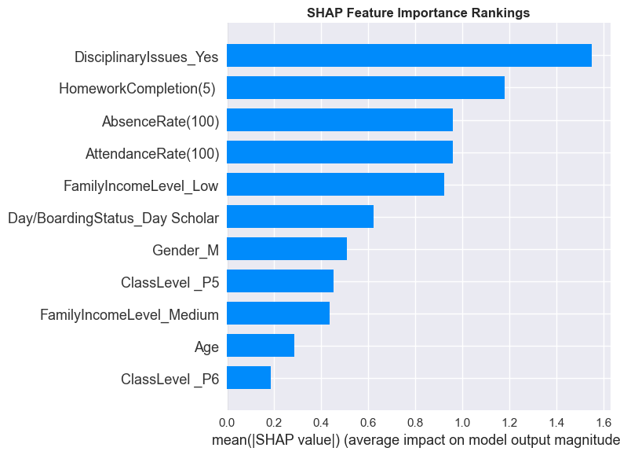
Results: Feature Importance (SHAP)
Key Insight:
Schools cannot change demographics, but they can monitor and respond to discipline, homework, and attendance, the factors that actually drive predictions.
Category | Top Features | Influence
Behavioural | Disciplinary Issues, Homework, Attendance | Highest
Socioeconomic | Family Income, Day/Boarding Status | Moderate
Demographic | Gender, Age, Class Level | Minimal

Slide 11
Results: Intervention Framework
Objective 3
Framework applied to 62 pupils in the test set (15% of total sample held out for final validation)
HIGH RISK
MODERATE RISK
LOW RISK
P ≥ 0.7
0.4 ≤ P < 0.7
P < 0.4
16.1%
4.8%
79.0%
Intensive support:
• Weekly check-ins
• Parental engagement
• Psychosocial support referral
• Academic tutoring
Targeted monitoring & support:
• Bi-weekly reviews
• Homework support
• Peer mentoring
• Teacher attention
Preventive monitoring:
• Standard oversight
• Periodic check-ins
• General support General support as needed
Key Resource Insight: Resource Efficiency: Intensive support needed for only 10 pupils (16.1%), allowing schools to concentrate resources on a manageable subset rather than spreading them thinly across all 409 pupils.

Slide 12
DISCUSSION
Key insight: This study achieved comparable performance with inherently interpretable Logistic Regression , no post-hoc explanation needed.
Key Findings in Context
Finding | Literature Support
1. Behavioural indicators predict risk | Aligns with Ahmed & Warsame (2024), Mnyawami et al. (2022), Herodotou et al. (2019)
2. Simple models can outperform complex ones | Supports Seo et al. (2024), Krüger et al. (2023) on interpretability
3. Poverty works through behaviour | Schools can monitor behavioural signs even if they cannot fix poverty (UBOS, 2023)
Performance Comparison
Study | Context | Model | Performance | Notes
This Study | Uganda Primary | Logistic Reg. | ROC-AUC: 0.941 | First for P4-P6
Ahmed & Warsame (2024) | Somaliland Secondary | Random Forest | Accuracy: 95% | Secondary level
Mnyawami et al. (2022) | Tanzania Secondary | Decision Tree | Accuracy: 99.8% | Regional data
Krüger et al. (2023) | Brazil | Explainable ML | AUC-PR: 89.5% | Required technical overhead
Khatun et al. (2025) | Bangladesh | XGBoost + SHAP | Accuracy: 94.4% | Required post-hoc explanation

Slide 13
RECOMMENDATIONS
For Schools & Teachers
For Policymakers
Future Research
• Use attendance/homework records as diagnostic tools
• Regular review in staff meetings
• Apply the tiered framework to focus intensive support on high-risk pupils
• Support early warning systems in schools through policy and funding
• Fund consistent data collection infrastructure
• Train staff to use data for preventive intervention
1. Validation across districts
2. Longitudinal investigation: Track pupils across multiple years to see how risk develops
3. Qualitative depth : Add absence reasons, teacher observations, pupil perspectives
This study provides a feasible, evidence-based foundation for shifting pupil support from reactive to proactive in resource-constrained settings.
Aligned with NDP IV priorities: improving access, equity, and quality of education

Slide 14
CONCLUSION
Objective 1
Objective 2
Objective 3
Behavioural indicators (discipline, homework, attendance) are the strongest predictors
Logistic Regression optimal:
Recall 0.833, ROC-AUC 0.941,
interpretable for teachers
Tiered framework converts predictions into personalised support
Research Gaps Addressed
✓ Geographical: Machine Learning model for Ugandan primary schools
✓ Practical Utility: Prioritised interpretability so teachers can actually use it
✓ Implementation: Predictions linked to concrete, actionable interventions
Significance:
Through systematic use of existing school records, educators in resource-constrained settings can identify vulnerable pupils early, based on modifiable behaviours, before disengagement leads to dropout.

